Slide 1
Global standards and benefits of Verified by GS1
Fortifying supply chains
understanding standards, a common language
Chrisian Zaeske 11.10.23

Slide 2
MULTICHANNEL
WHOLESALER
DIGITAL
Marketplace
Customer App
Online Ordering
DIGITAL SOLUTIONS FOR
CUSTOMERS
Wholesale Stores
FSD
Out-of- Store
As of: 30 September 2022
© METRO AG.

Slide 3
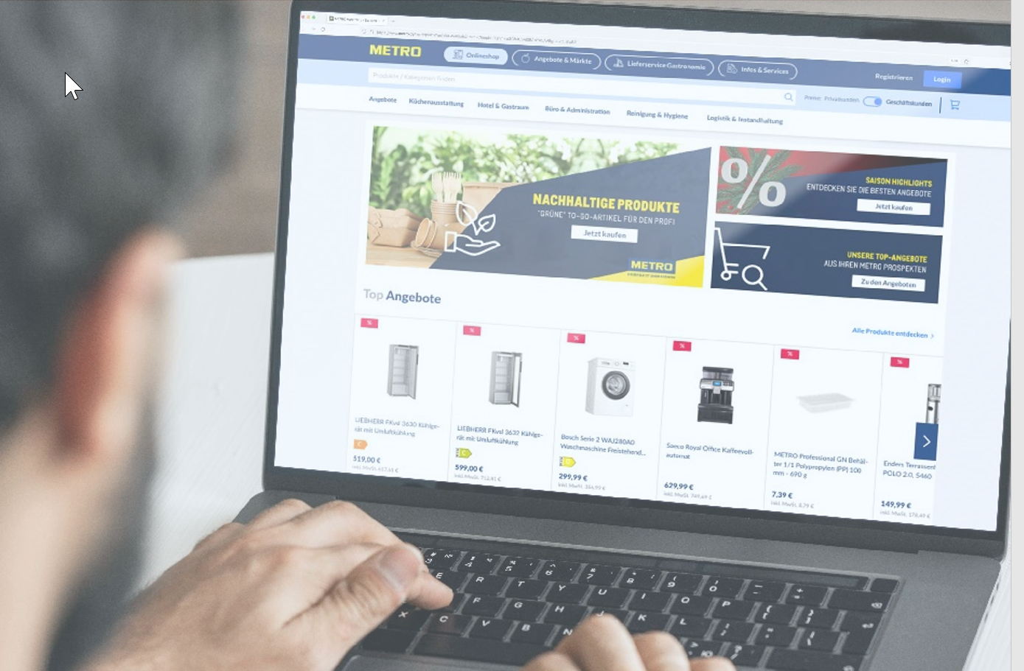
Trusted Data ?

Slide 4
Metro GS1 global priorities
GTIN Ubiquity A globally unique identifier on every trading product
Verified by GS1 product verification
Global Data Model omnichannel product master data set across all markets
2D Retail Sunrise 2027 „one barcode for all”

Slide 5
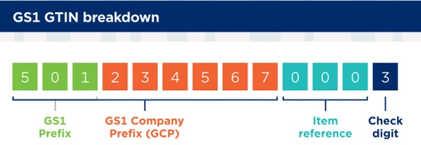
GTIN Ubiquity
Value: E2E transparency
(traceability, regulatory, sustainability)
Identifier is everything!!
Global product identity relies on unique identification
Respect GTIN Management Standard
Quality of GTINs usage
Internal numbering vs GTIN is just an attribute
Challenges: Rules not clear / respected reasons for not changing GTINs (listing fees, operational hurdles)

Slide 6
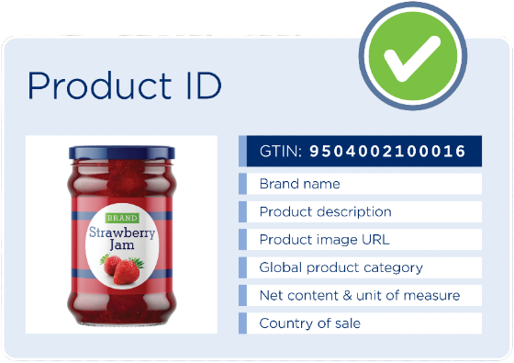
Trust and efficiency start with a valid ID.
Get product identity right with Verified by GS1.
Notes:
Trust and efficiency start with a valid ID. Get product identity right with Verified by GS1.
Verified by GS1 is to products what an ID card or passport is to people.
For people, an ID card contains one ID number and 7 core attributes: ID number (or social security number in the US), first name, last name, date of birth, place of birth, nationality, gender, picture. Registries of these data allow customs to verify a person’s ID and allow him/her to enter a country or not.

Slide 7
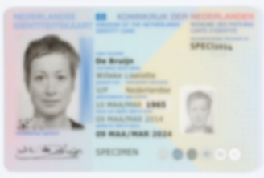
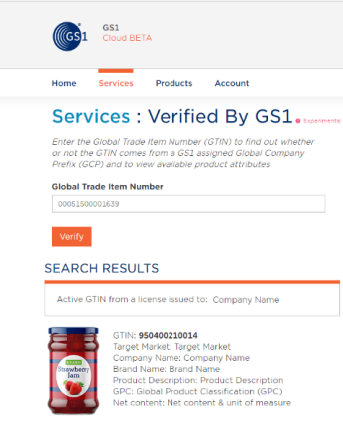
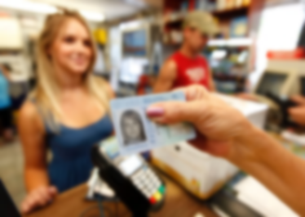
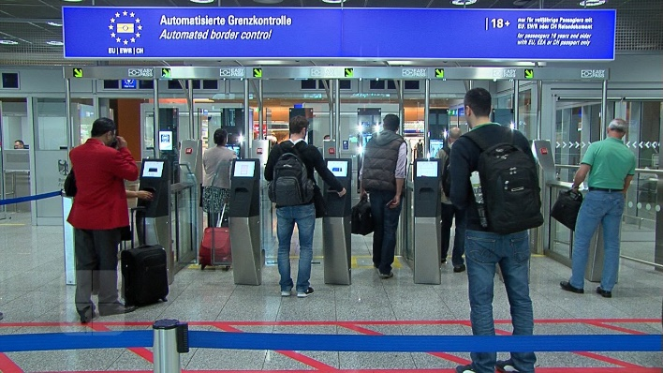
Going through customs…
https://www.gs1.org/services/verified-by-gs1

Slide 8
VbG Data Out – Our Motivation
Customer
Our Customers decide base on complete and correct product information
Trust
Verified product information create trust along all parties of the value chain
Security
Verification of products bevor listing,
especially via distributors and market place sellers

Slide 9
Current METRO Use Cases
METRO verify product before Listing
METRO verify active assortment
METRO verify Marketplace product before Listing
METRO Customer verify products
Verified by GS1
Brand Owner
Distributor
METRO
METRO Customer
Marketplace Seller
Dataflow (simplified)
Verification

Slide 10
Content is King
vs. 100% compliance GTIN alloc. rules
vs. METRO CHEF
vs. 200g MC ZIEGENWK ROLLE MIND.45
vs. ./.
vs. ?
vs. 1 PCS
vs. ./. Or product not specified for TM

Slide 11
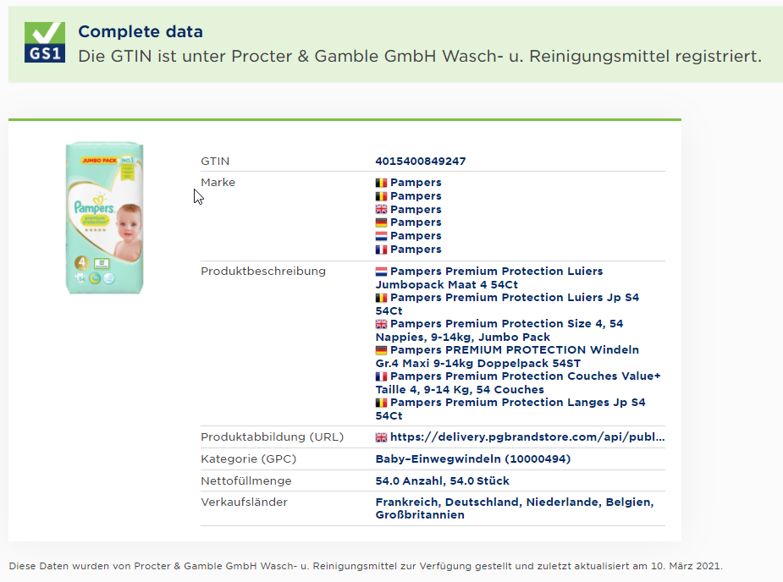
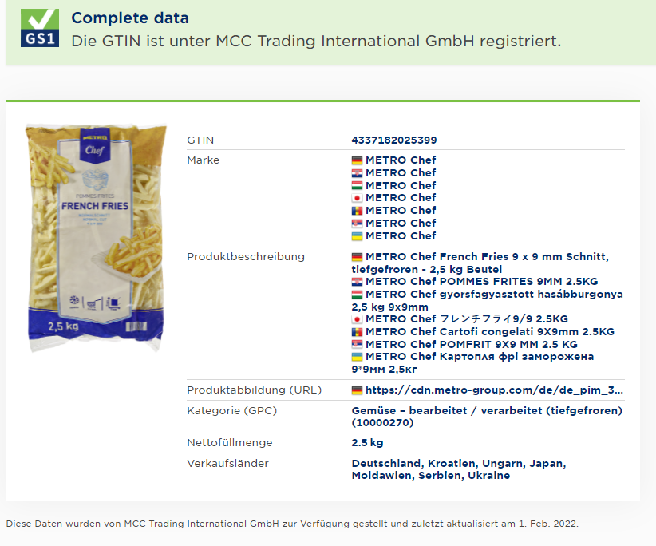
Product examples @ VbG

Slide 12
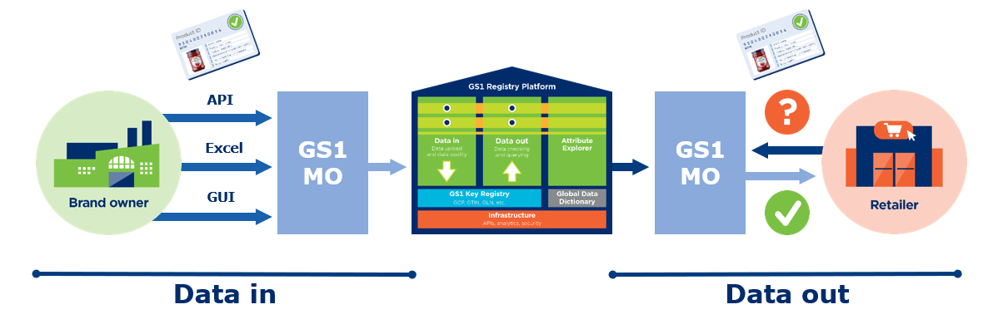
METRO Privat Lable Data IN
Product master data provisioning process
per METRO country of sale*
per METRO corporate function
Verified by GS1
GS1 Global
Registry
select
products
deliver data
select
products
deliver data
provide
select
products
deliver data
Consolidate & add GPC
Check & approve*
select
products
deliver data
per METRO brand owner GCP, GTIN
Per GTIN, Traget Market

Slide 13
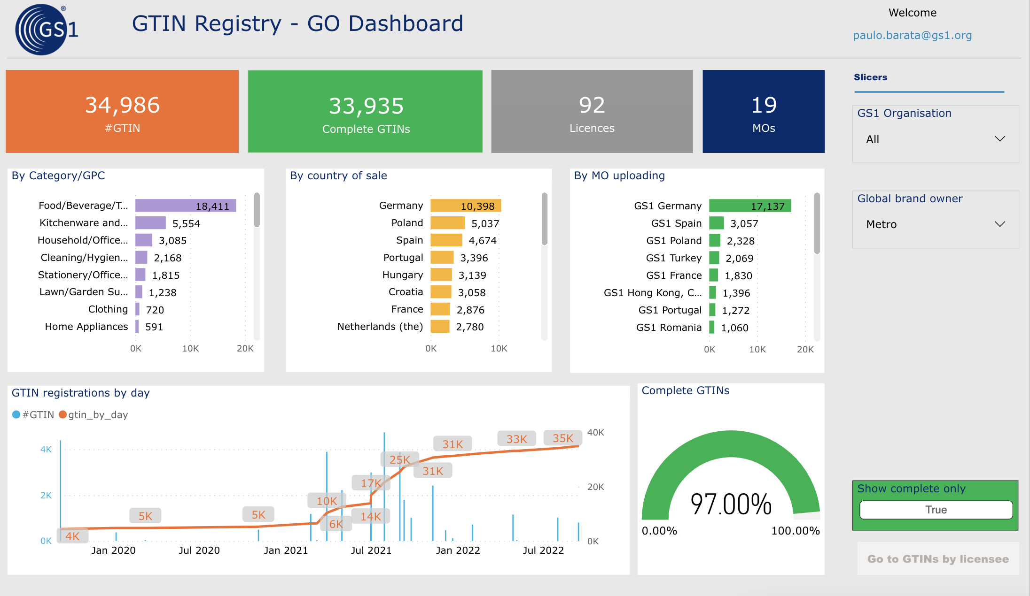
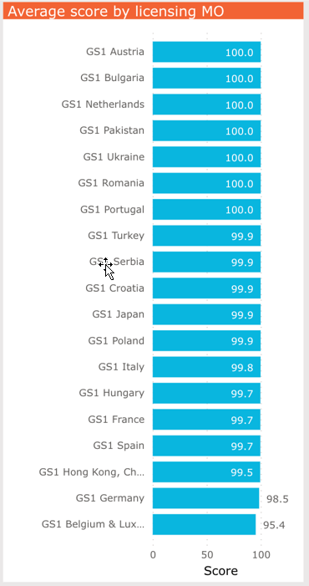
GS1 VbG DQ Scorcard
Value: Data quality and consistency improvement
Improve Load
Improve Data Quality of the Load
Queries
Challenges: Retailer Use Case only once a market gets above threshold

Slide 14
Global Data Model
The GS1 Global Data Model Standard is the set of foundational data attributes that are needed to list, order, move, store and sell products.
Global core layer
GTIN
Image
Local (xx)
Regional (47)
Global category layer
Ingredients
Nutritional facts
Global (28)
Core (54)
Regional category layer
Package material
Allergen statement
Country layer
Order quantity minimum
VAT
One product. One experience. Every channel. Every Country

Slide 15
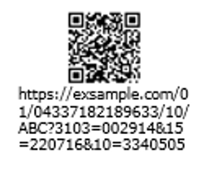
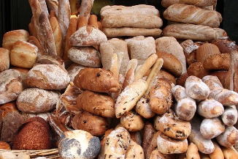
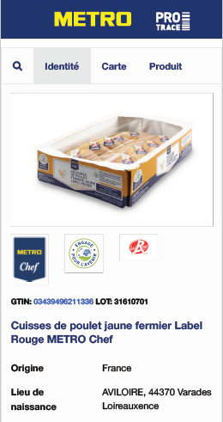
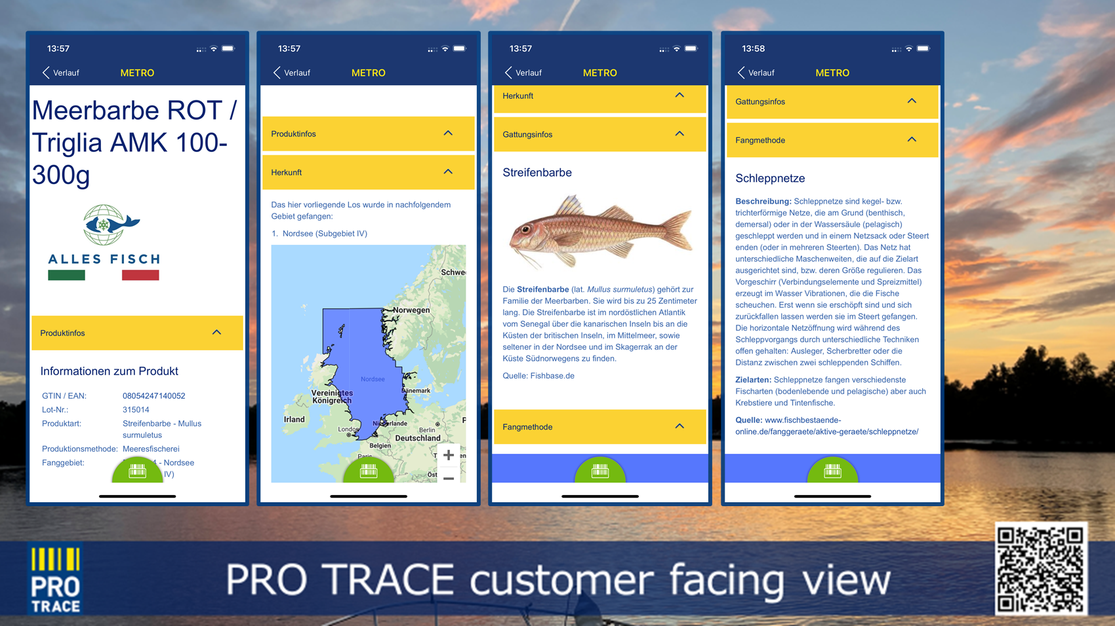
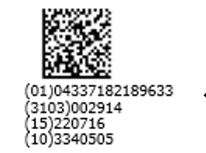
METRO 2D Journey
A journey from EAN to Data Matrix and QR with GS1 Digital Link and target group specific content
+

Slide 16
One product.
One experience.
Every channel.
Every country.
christian.zaeske@metro.de

